Slide 1
Presenter notes
Resources:
Product page for Action runners
Docs: About self hosted runners
Docs: About self hosted runners (usage limits)
Docs: Virtual environments for self hosted runners
Docs: Software installed on GitHub hosted runners
Automate with self hosted runners
Blog: Scaling self hosted runners
Demo prep:
No demos in this presentation
FAQ:
FAQ slides at end
Customer stories:
X
Expected timing:

Slide 2
Self-hosted runners
GitHub Bootcamp
@presenter name (optional)

Slide 3
This module will enable you to:
Define and explain what self-hosted runners are
Identify when to use self-hosted runners
Discuss the management, automation and scaling of self-hosted runners

Slide 4

Runners
GitHub hosted
Self-hosted
Automatic updates
Managed and maintained by GitHub
Clean instance for every job execution
Pricing
Open source
Automatic updates for self-hosted runner application only
Customizable
Responsible for cost of runner machines
GitHub recommends AGAINST self-hosted runners for public repositories
Notes:
GitHub-hosted vs self-hosted runners is a common topic for customers
Let's contrast GitHub-hosted runners to self-hosted runners.
GitHub hosted
Receive automatic updates for the operating system, pre-installed packages and tools, and the self-hosted runner application.
Are managed and maintained by GitHub.
Provide a clean instance for every job execution.
Use free minutes on your GitHub plan, with per-minute rates applied after surpassing the free minutes.
Self-hosted
Receive automatic updates for the self-hosted runner application only. You are responsible updating the operating system and all other software.
Can use cloud services or local machines that you already pay for.
Are customizable to your hardware, operating system, software, and security requirements. Create your own custom runner w/ whatever customizations you need (more hardware, OS, on-prem, in cloud, etc)
Don't need to have a clean instance for every job execution.
Are available to use with GitHub Actions, but you are responsible for the cost of maintaining your runner machines.
Important: GitHub recommends AGAINST using self-hosted runners for public repos
Consider this: A self hosted runner on premises, behind a firewall, and the IP is hidden. But, the repository is public, and someone may trigger the workflows in untended ways through forking or contributing through forks.
Leverage the IP allow list for self-hosted runner security
Considerations when using self-hosted runners:
Self-hosted runners give you more control over the division of runner resources. The ability to decide who has access to your runners is an additional advantage. As you consider implementation, you will need to calculate infrastructure costs as well as a strategy for runner redundancy.
Q: Why would I choose a self-hosted runner over one that is GitHub-hosted?
A: There are several reasons. Some of them include the following:
Data sovereignty - The customer needs the runners to be physically located in a specific country, or within a specific private cloud such as Azure Gov or similar.
Network access - The runners need to have access to private networks for tasks such as integration testing, artifact publishing or deployment.
Hardware requirements - You may need your actions to run on a specific type of hardware that is not available in the hosted pool. If any of the resources used in the hosted pool are too small or too slow (such as the number of VM CPUs, the amount of storage or RAM) the self-hosted method provides the flexibility you require.
Software requirements - You may need specific software or operating systems to be installed or running on the VMs that is not available in the hosted pools.
Cost - You may have an agreement with another cloud vendor and through your agreements with them your computing costs may be lower.
******************************
Resources
https://github.com/actions/runner
******************************

Slide 5
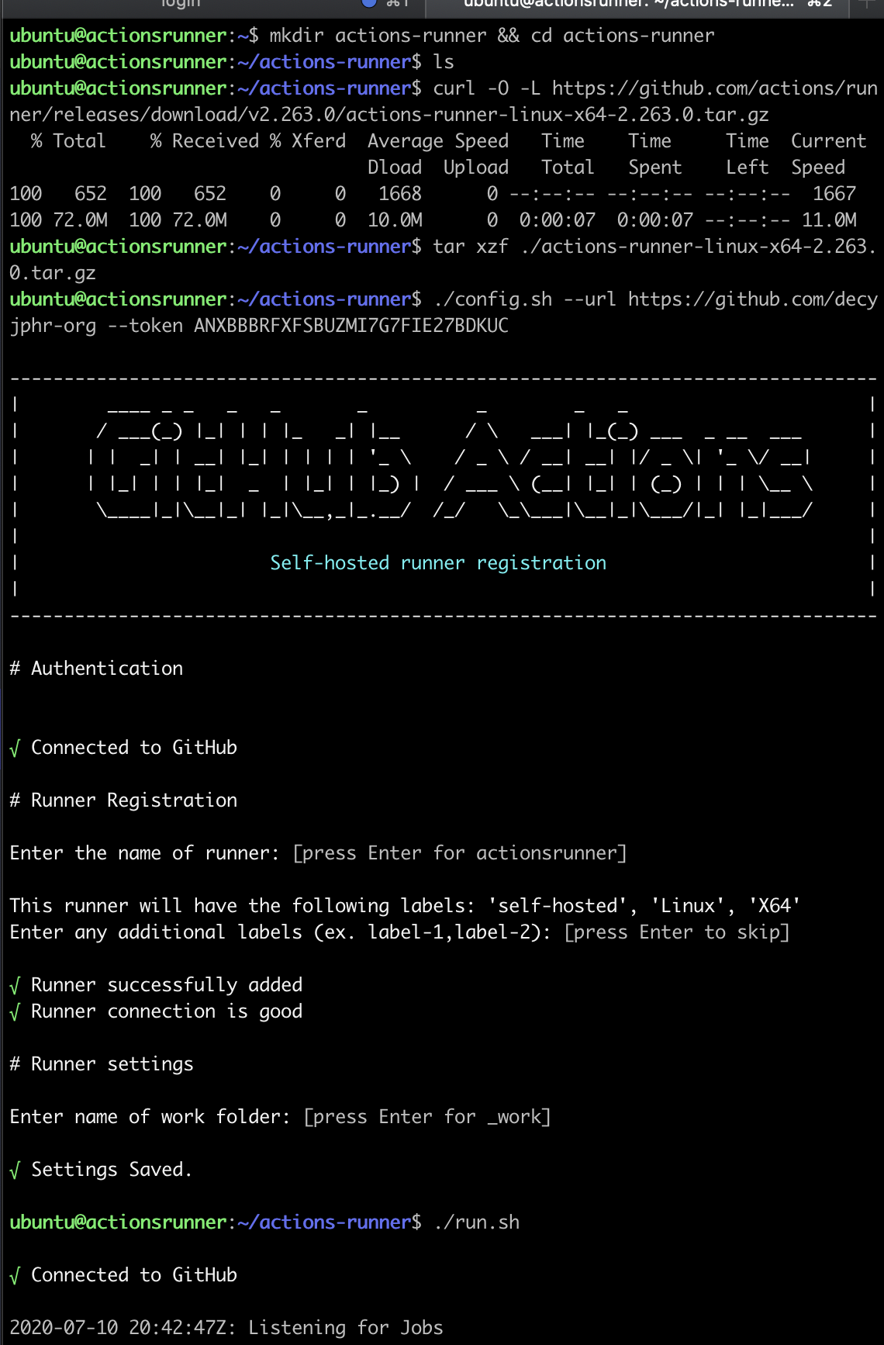
Configure self-hosted runners
Download and extract the scripts
Configure and authenticate the runner with the token
Start listening for jobs
Notes:
Open source: community runners available to do different things, like have a local runner on your desktop and execute Action testing locally
Just a few steps to get self-hosted runners up and going, with plenty of supporting documentation
********
Resources
Hosting your own, usage limits: https://docs.github.com/en/actions/hosting-your-own-runners/about-self-hosted-runners#usage-limits
- https://docs.github.com/en/actions/reference/virtual-environments-for-github-hosted-runners
- https://docs.github.com/en/actions/reference/software-installed-on-github-hosted-runners
********

Slide 6
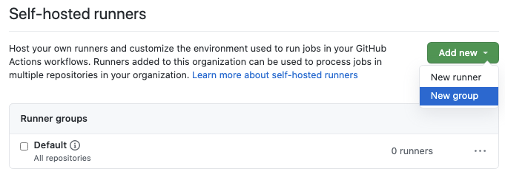
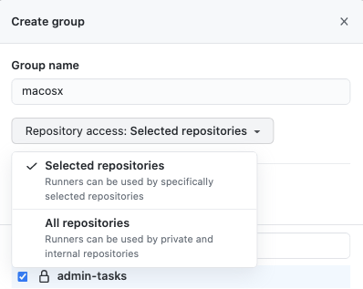
Runner groups
Configure on enterprise and/or organization level
Scope to specific organizations and/or repositories
Move runners between groups
A runner can only be in one group at a time
Notes:
GitHub-hosted vs self-hosted runners is a common topic for customers
The groups in GitHub are similar to the execution pools in Azure DevOps. So you could, for example, have a machine running Linux and it can run dot net core. You could have another machine that has the capability to say this is running the Windows and then running .net core and then you could then eventually, say, Okay, I need to, you know, when I'm executed. I just need a machine with.net core, then you're either one of those could good service that or you could say, you know, I need to have Linux so you can you can set up some, some of the things you can in Azure DevOps.

Slide 7

Runner node configuration
Best practices:
Create a dedicated user for the Actions runner
Enable limited sudo
Run the Actions runner inside Docker
Notes:
Many of your Actions may require root access in order to run. For example, if you are running an Action with Python natively, you may need to run sudo if you’re checking out the dschep/install-pipenv-action@v1 Action, as that runs sudo in order to install the necessary dependencies. In cases like this you may choose to avoid the Action, or you can limit the scope of your runner’s permissions.
********
Resources
https://docs.github.com/en/actions/hosting-your-own-runners/about-self-hosted-runners
********

Slide 8

Security risks of public runners
Public repositories with self-hosted runners pose potential risks.
Malicious programs run on the machine
Escape the machine’s runner sandbox
Expose access to machine’s network
Persist unwanted/dangerous data
Notes:
Self host with private repos only
Forked repositories will contain the same Actions configuration as the parent repository, including the self-hosted runners. Creates the potential for a fork to run malicious code on a runner inside your network. For this reason, it is highly recommended to use self-hosted runners only with private repositories.
********
Resources
https://docs.github.com/en/actions/hosting-your-own-runners/about-self-hosted-runners
*******

Slide 9
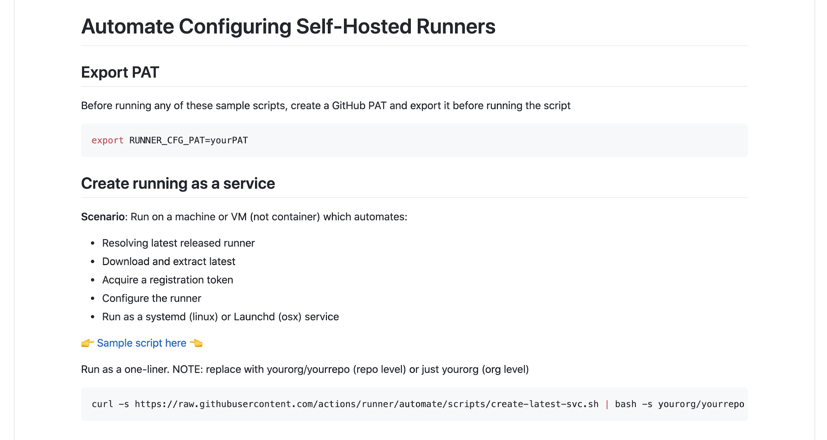
https://github.com/actions/runner/blob/main/docs/automate.md
Notes:
Resolve the latest released runner
Download and extract latest
Acquire a registration token
Configure the runner
Run as a systemd (linux) or Launchd (osx) service
********
Resources
https://github.com/actions/runner/blob/master/docs/automate.md
********

Slide 10
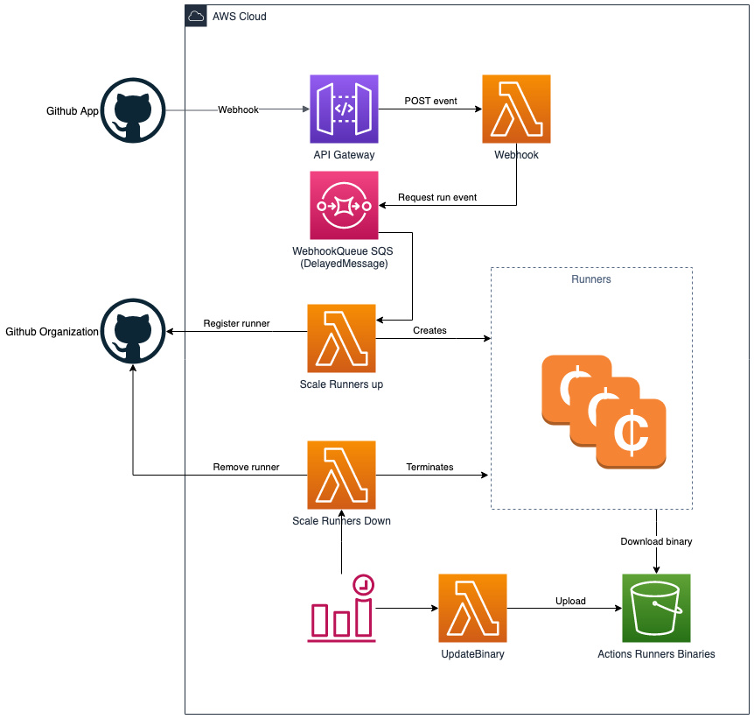
Dynamically scale runners
Make actual runners ephemeral and immutable
AWS specific but could be extended
Example architecture
Notes:
Blog post: run GitHub actions on self-hosted scalable runners on AWS spot instances.
First a lambda to handle the GitHub events
Two lambda’s for scaling up and down.
Last one to synchronize the runner binary. The self-hosted runners will run on AWS spot instances.
An example of dynamically scaling runers with Kubernetes: https://github.com/summerwind/actions-runner-controller
********
Resources
https://040code.github.io/2020/05/25/scaling-selfhosted-action-runners
********

Slide 11
Questions
Notes:
********************
Note to presenter:
The questions below are for your reference only. They are ones that you can anticipate receiving from the audience. However, there is no need to pose these to your audience.
********************
Q: How can I see what software is included in the hosted runner?
A: The config.yml file is the primary location in which you should link to dependencies.
Click on the image you want to see: https://github.com/actions/virtual-environments
Q: Hosted runners can run up to how many minutes each time?
A: The default per job is 360 minutes, but can be changed with jobs.<job_id>.timeout-minutes https://docs.github.com/en/free-pro-team@latest/actions/reference/workflow-syntax-for-github-actions#jobsjob_idtimeout-minutes

